Slide 1

Pawsome
Prepare by :
Hetvi Purohit - IT105
Raj Vaghela - IT106
Internal Guide: Prof. Archana Vyas
Dept. of Information Tech. Faculty of Technology D D University

Slide 2
Contents
◦ Objective
◦ Overview
◦ Scope
◦ Software Architecture & Requirements
◦ Summary of Work Done
◦ SRS and Use-Case
◦ Diagrams
◦ Screen Shots and Test Case
◦ Conclusion
◦ Future Expansion
◦ References

Slide 3
Objective
This whole pandemic has taught a all lot about all services we need and how they can be shifted to a virtual platform. Why not for our dear pets too?
A cat, dog or in fact any other pet have needs like doctors assistance, daily products, play school.
This project is made to satisfy all you pets need and pet relate need at one stop.

Slide 4
Overview
We focused on connecting potential pet buyers to potential pet sellers.
E-commerce for pet related products (right from dressing items to food)
Booking appointments with a daycare facility
Booking appointments with a caretaker
Assistance from a veterinary doctor
Portal for caretaker wherein he can handle his bookings.

Slide 5
Scope
There are only three user for now - Admin, End User, Caretaker
End User can be someone who is looking for a pet or looking for pet related services
Admin portal is the default portal provided by Django
Caretaker portal is been made where a caretaker can handle his booking activity.

Slide 6
Software Architecture and Requirements
The web application is divided into 2 parts :
Frontend - HTML, CSS, Bootstrap
Backend - Django framework written in python language
After hosting of website, anyone with a browser supporting the above languages can access our website without any issue

Slide 7
Summary of Work Done
No. of Use Case - 15
No. of Sequence Diagram - 8
No. of Flow Chart - 4
No. of Class Diagram - 1

Slide 8
System Requirements Specification
(End User or Caretaker)
R.1 Sign Up (Click on “Register” option in menu bar)
Description: For the users to access some features of this website registration is a must.
Pre-Condition: The user should not be already registered. It has
to be a new account.
Input: The user enter detail : Username, First Name, Last Name, Email and Password
Output: Redirected to home page.
Post-Condition: The data is stored in the database.
R.2 Sign In (Log In)
Description: Only registered users can have access.
Pre-Condition: The user should be already registered.
Input: The user enters username and password.
Processing: Checks whether the user is already registered and password is correct or not.
Output: User logged in.
Post-Condition: Redirected to home page.
(End user only)
R.3 Chat Bot
Description: A chat bot has been implemented to answer questions of user
Pre-Condition: None
Input: Any question that a user has
Processing: Uses universal database to find answer of question
Output: Answer of question
Post-Condition: Same page
R.4 Buy Pet
Description: An interested buyer can brower pets from the option provided by us, if he find some pet interesting he can contact the owner of the pet
Pre-Condition: Click on “buy pet”
Input: Clicks on “Contact Breeder”
Output: Takes to the contact page of breeder
Post-Condition: User can continue with any activity on website
R.5 Buy Pet Product
Description: A user who wants to buy any pet product can surf from the given options on website and buy them
Pre-Condition: Click on “buy pet product”
Input: Click on “Quick View” to get detailed information of product
Output: Page with details of the product
Post-Condition: User can add to cart or move on to some other activity on website

Slide 9
System Requirements Specification
R.6 Cart
Description: Add to cart is a way to temporarily add items by adding them to your cart which will keep track of your items you want to buy on our website.
Input: Click the “Add to Cart” button.
Output: A side drawer will appear on the right side and items will be added to cart.
Post-Condition: User can see the added product in the cart. User can also edit the cart.
R.7 Checkout
Description: checkout is the next step (after cart) in the processing of buying a product.
Pre-Condition: Some product in cart
Input: Click on “checkout”
Output: Redirect to checkout page
Post-Condition: Calculates the final amount based on products in cart. Fill in the details on checkout page for delivery of product.
R.8 Payment
Description: After filling in checkout details, place order and choose payment option
Pre-Condition: Checkout details should be filled
Input: Click on “Place Order”
Output: Redirects to payment page.
Post-Condition: On Payment page from the give option (eg. paytm) choose one. After successful placement of order, product ID will be displayed.
R.9 Daycare
Description: Daycare is a facility where a pet owner can leave his pet for some pre-decided amount of time. It is like a hostel for pets
Pre-Condition: User should be registered user and on the daycare page. From the available options, user can use any daycare facility.
Input: Click on “Book Slot”
Output: Redirect to booking slot page
Post-Condition: Based on the input (valid user/ valid dates) result will be displayed.

Slide 10
System Requirements Specification
R.10 Caretaker
Description: Caretaker is a facility where a pet owner can book a person to come to their house and take care of their pets. Like a at home service.
Pre-Condition: User should be registered user and on the caretaker page. From the available options, user can use any caretaker.
Input: Click on “Book Slot”
Output: Redirect to booking slot page
Post-Condition: Based on the input (valid user/ valid dates) result will be displayed.
R.11 Ask a Vet
Description: A user can get the contact details of a veterinarian.
Pre-Condition: User should be registered user and on the ask a vet. From the available options, user can get contact detail of any doctor.
Input: Click on “Contact”
Output: Redirect to the contact page of the doctor.
R.12 Contact Us
Description: If a customer wants to make any kind of contact with the admins of the system hen they can fill up a form and leave their feedback or queries
Input: On Contact us page full the form and click on submit.
R.13 Log Out
Description: To leave the website, logout/checkout from the website.
Pre-Condition: Users should be logged in.
Input: Click the ‘Logout’ button.
Output: User is logged out and redirected to the login page.
Post-Condition: None.
(For Caretaker Only)
R.14 Register
Description: To get registered on a website as a caretaker, he or she will have to fill in a form including their personal details like name, contact details, photo.
Input: Click the “Register as Caretaker” button.
Processing: Information will be stored in the database and will also be displayed on the caretaker page.
R.15 Booking Activity
Description: Through this the caretaker can either accept or reject an appointment based on his convenience.
Input: Sends response to the end user according to his willingness of taking the appointment.

Slide 11
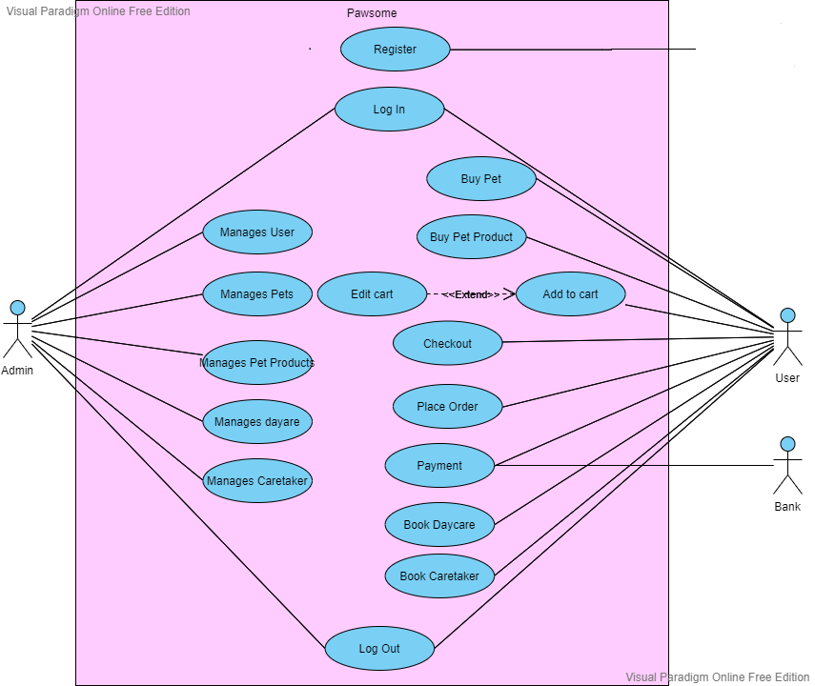
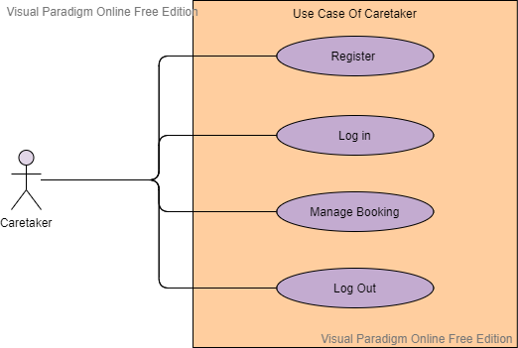
Use Case diagram

Slide 12
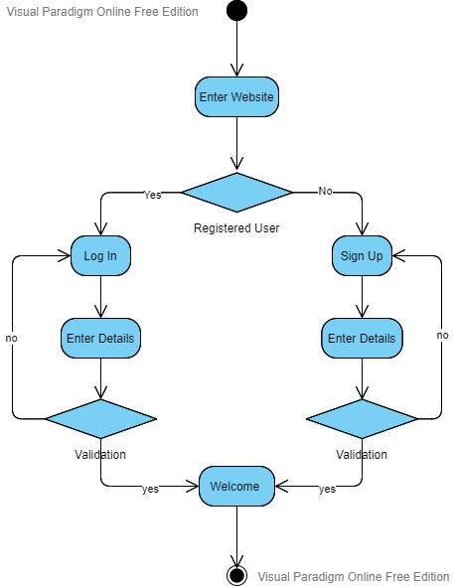
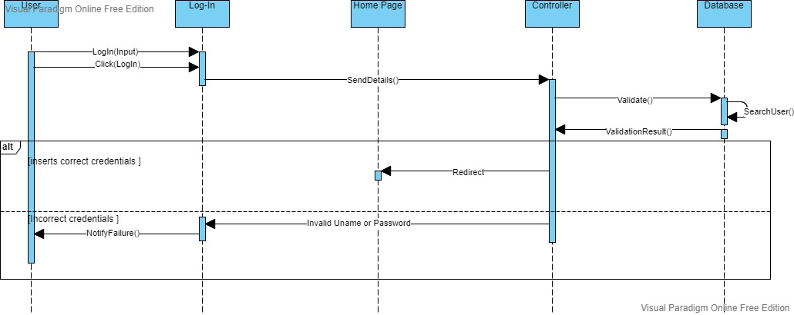
Diagrams

Slide 13
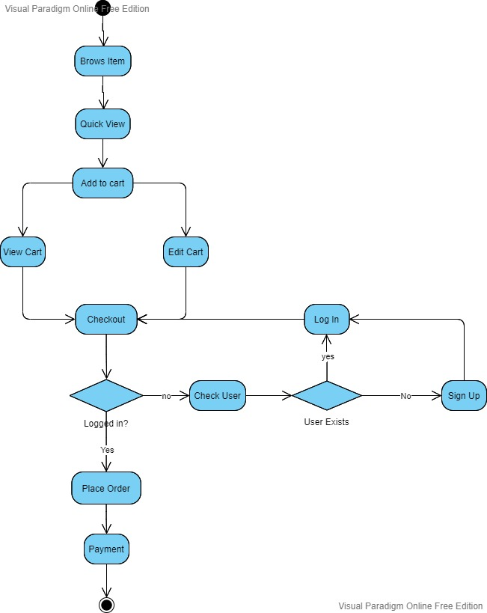
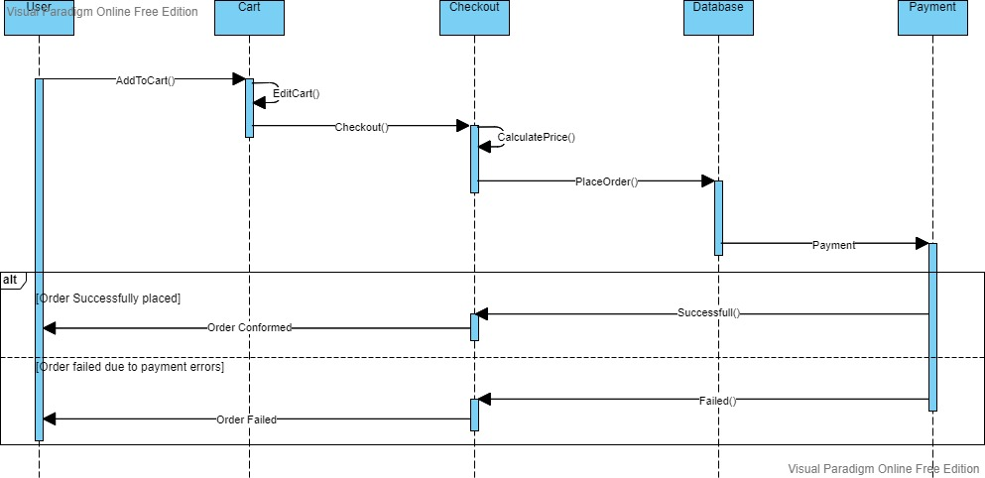
Diagrams

Slide 14
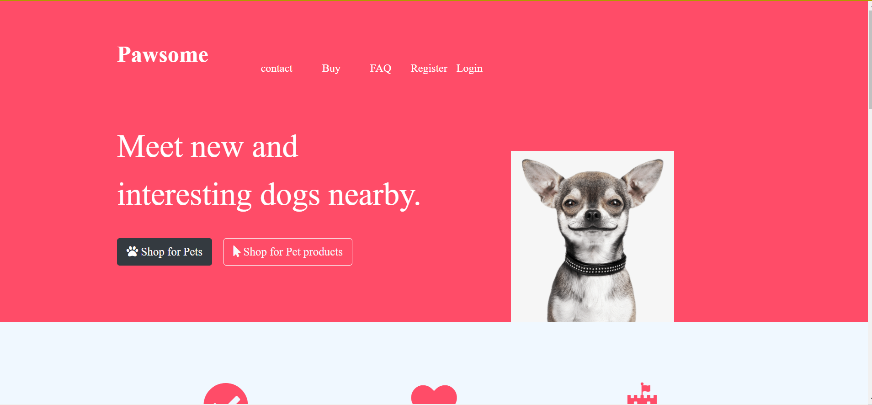
Pawsome Index - without log in

Slide 15
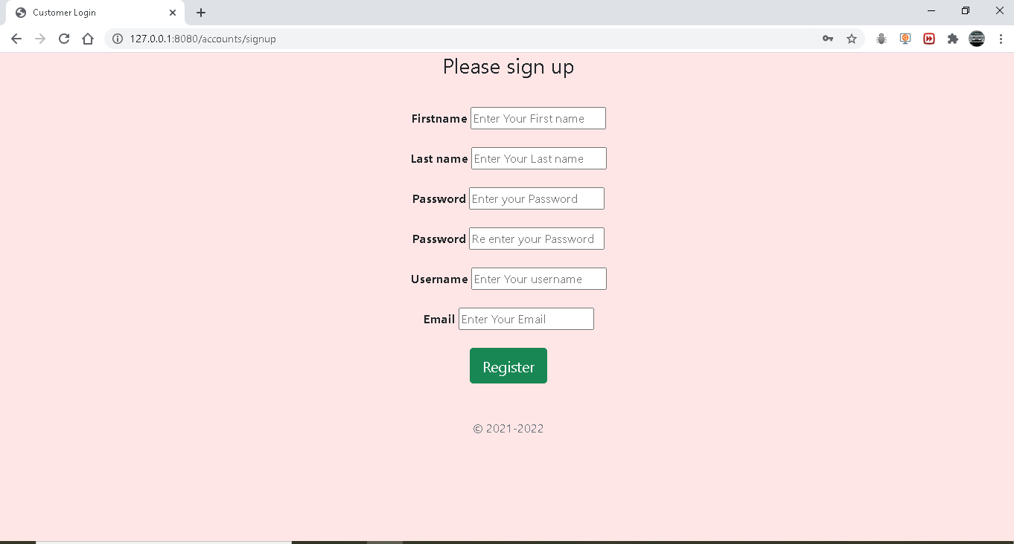
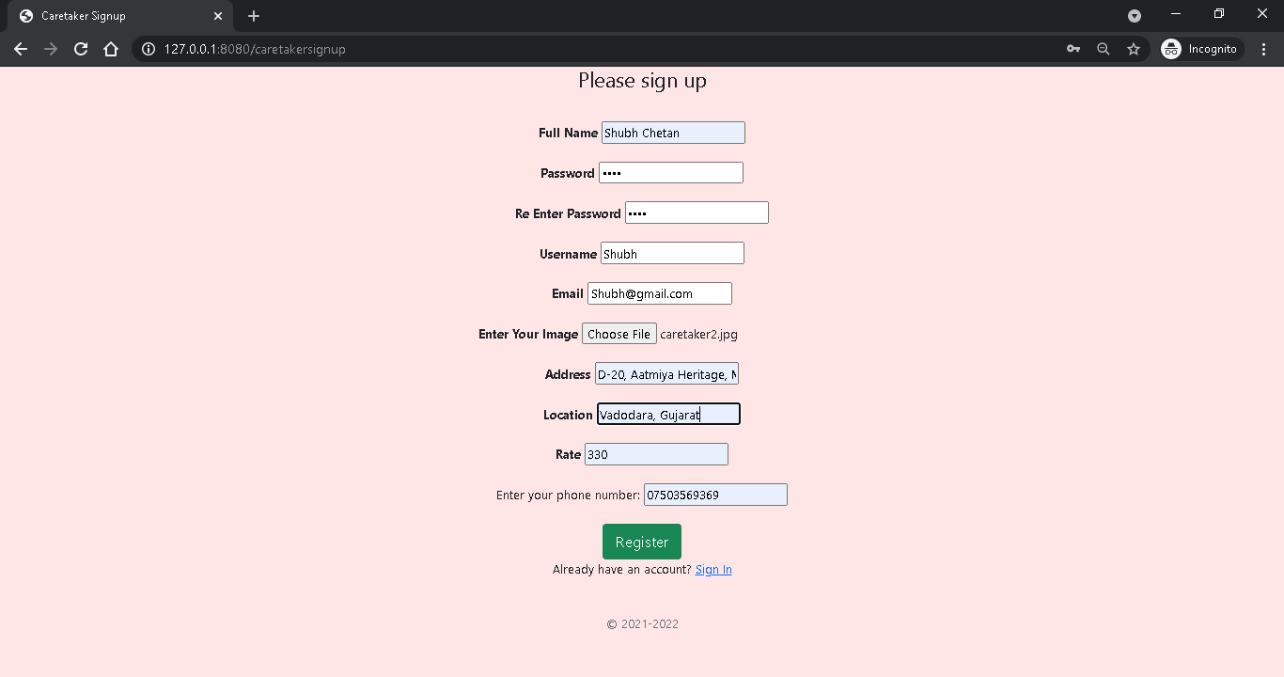
Sign Up
End User :- Caretaker :-

Slide 16
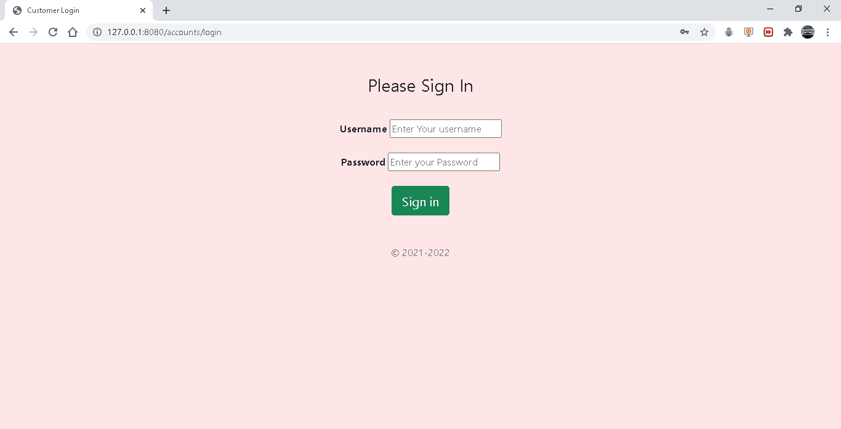
Sign In

Slide 17
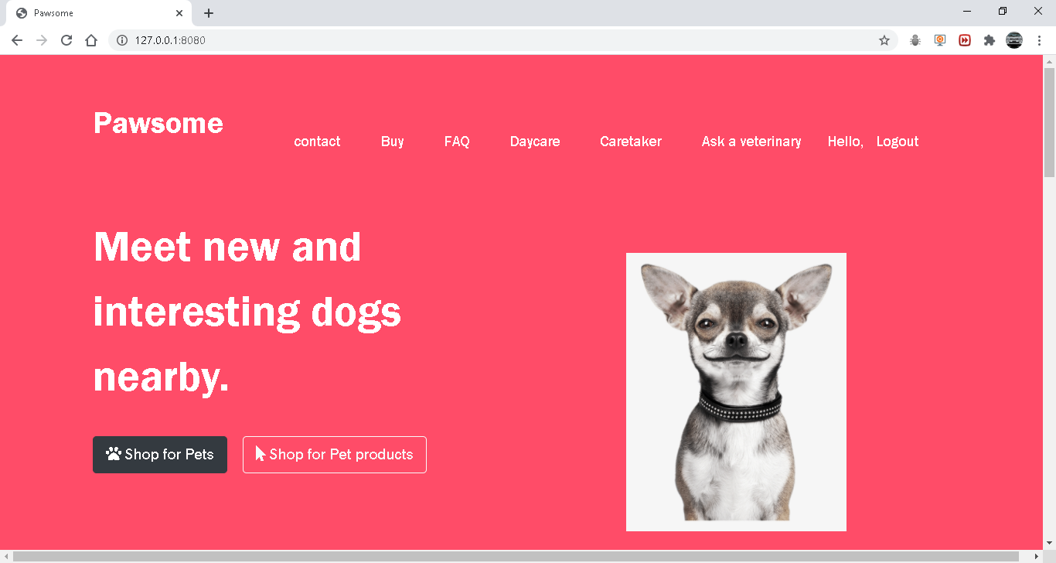
Pawsome Index - After Log In

Slide 18
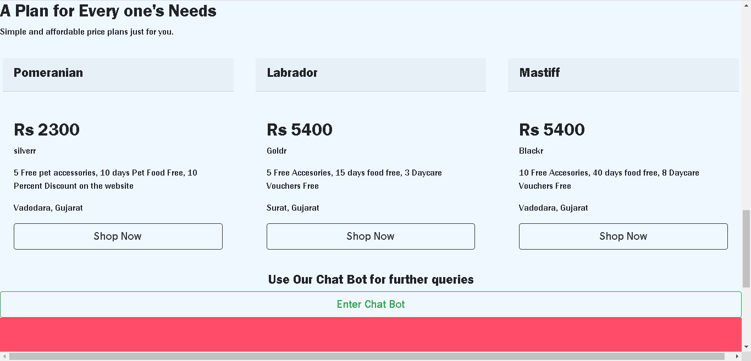
Pawsome Index

Slide 19
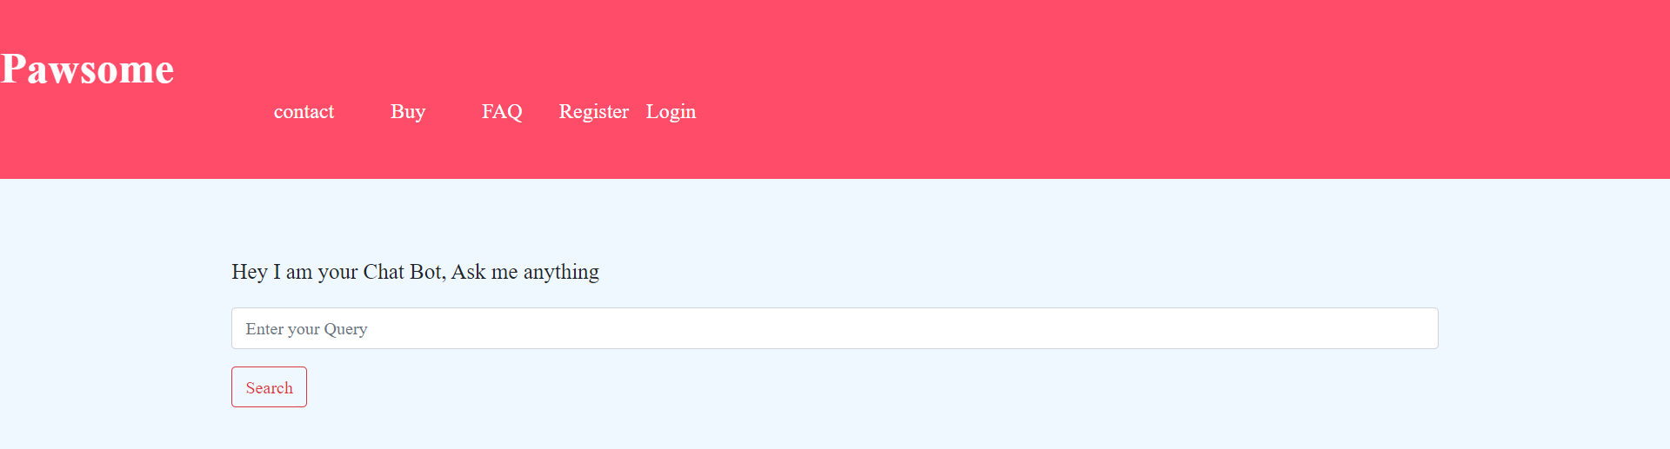
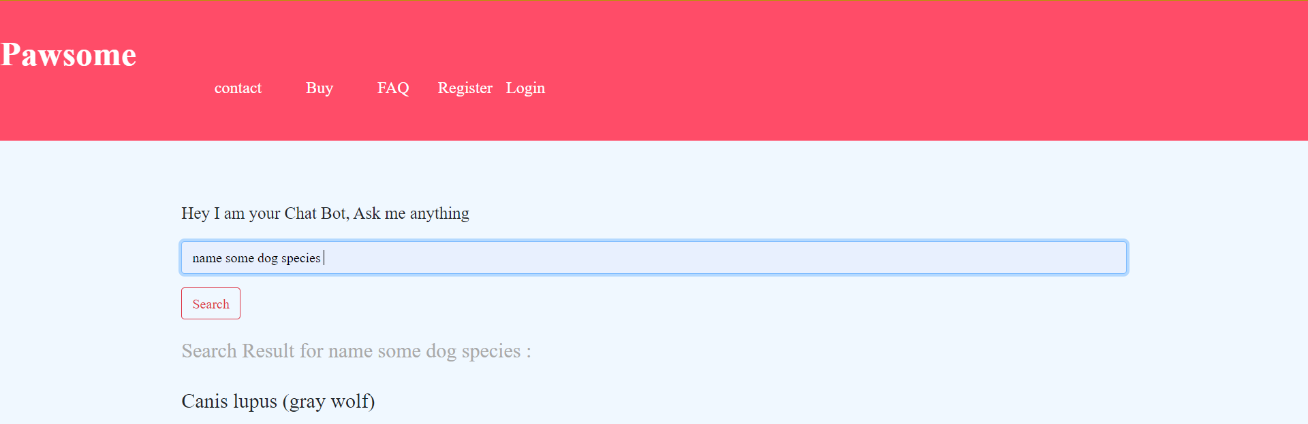
Chat Bot

Slide 20
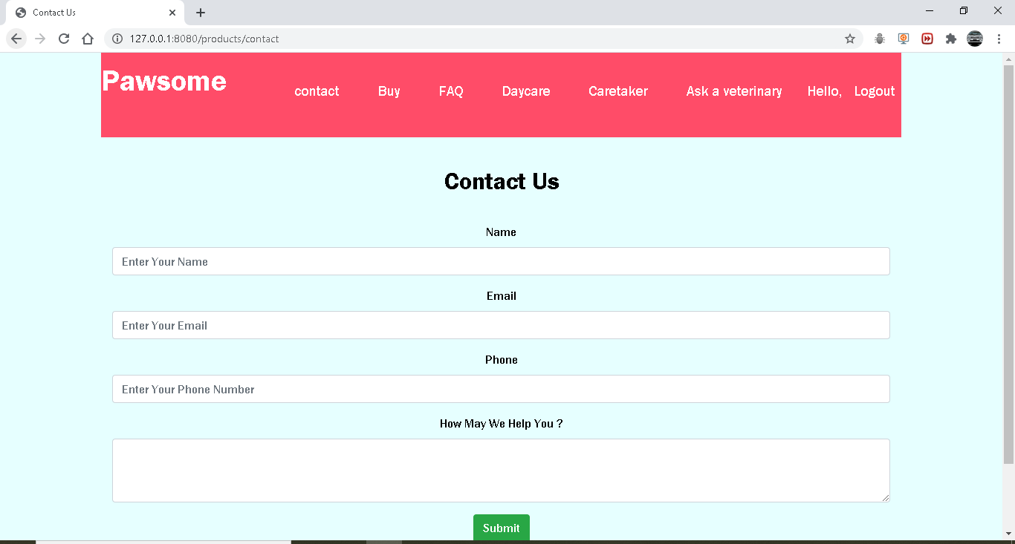
Contact Us

Slide 21
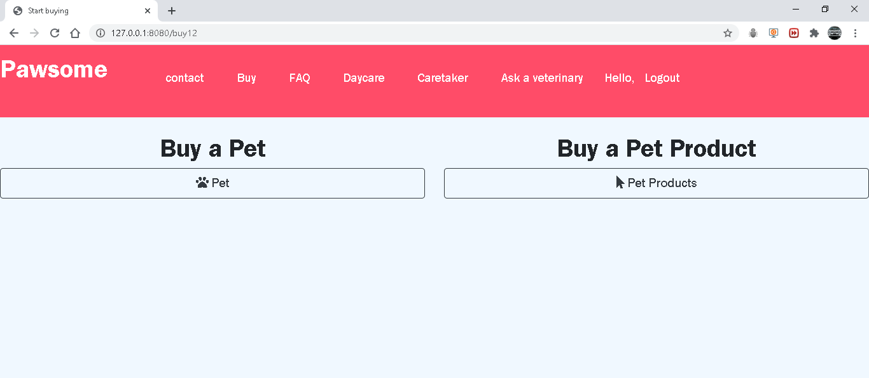
Buy

Slide 22
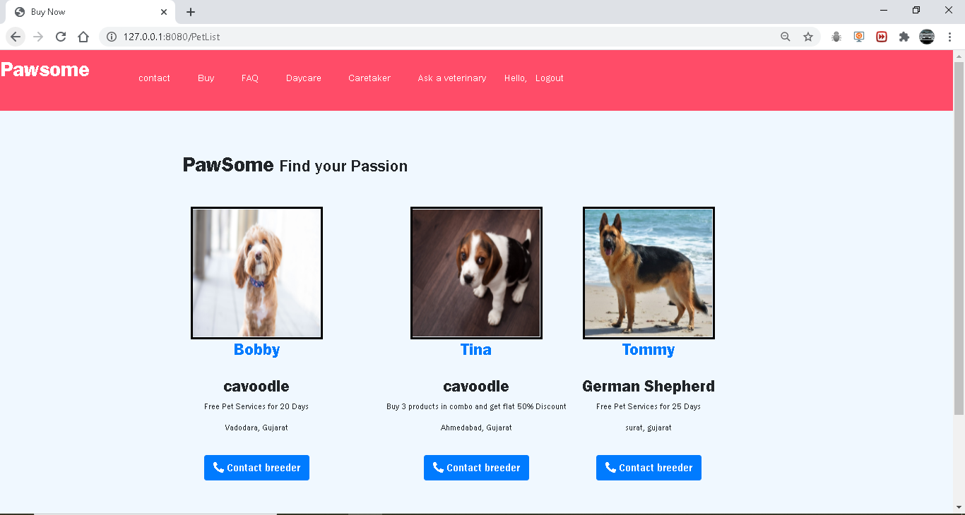
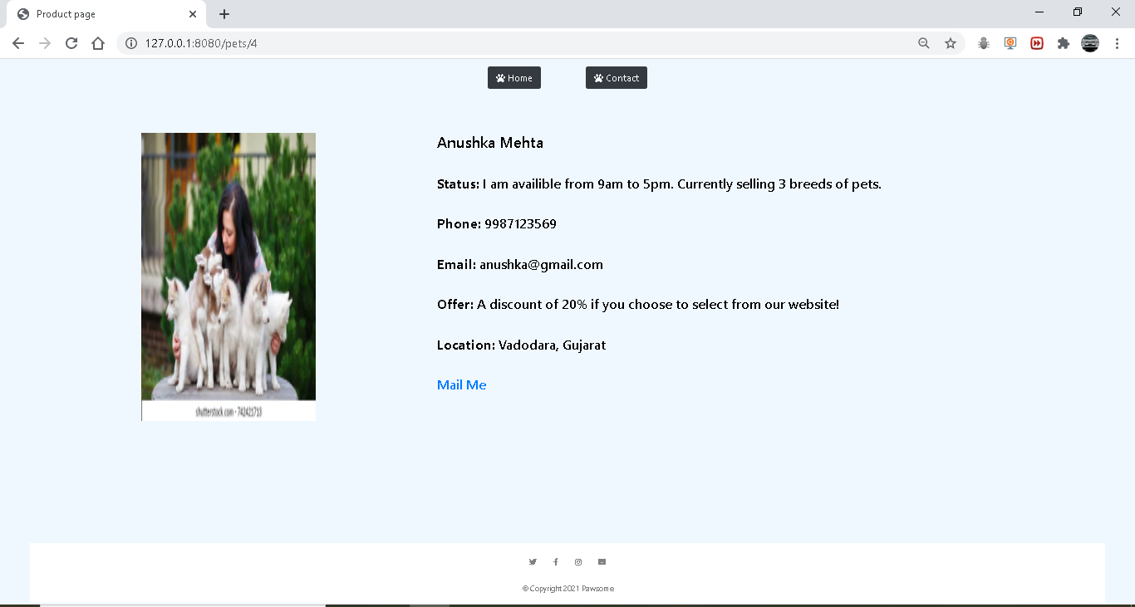
Buy - Pet
Contact Pet Owner

Slide 23
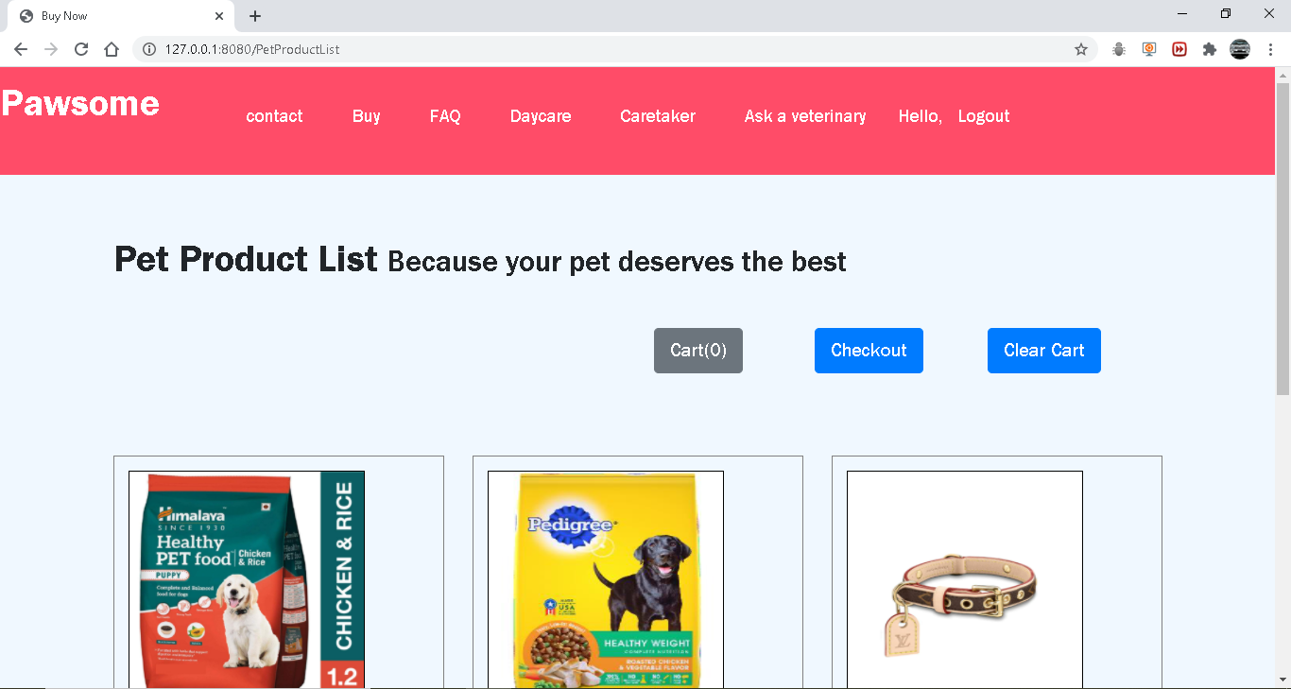
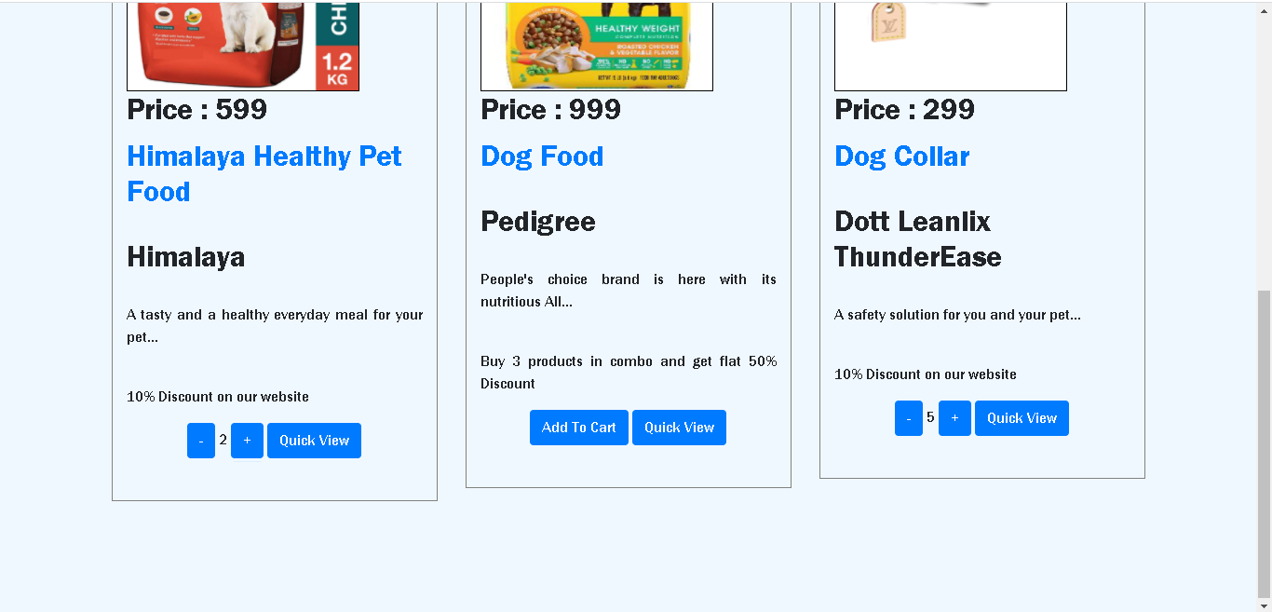
Buy - Pet Product

Slide 24
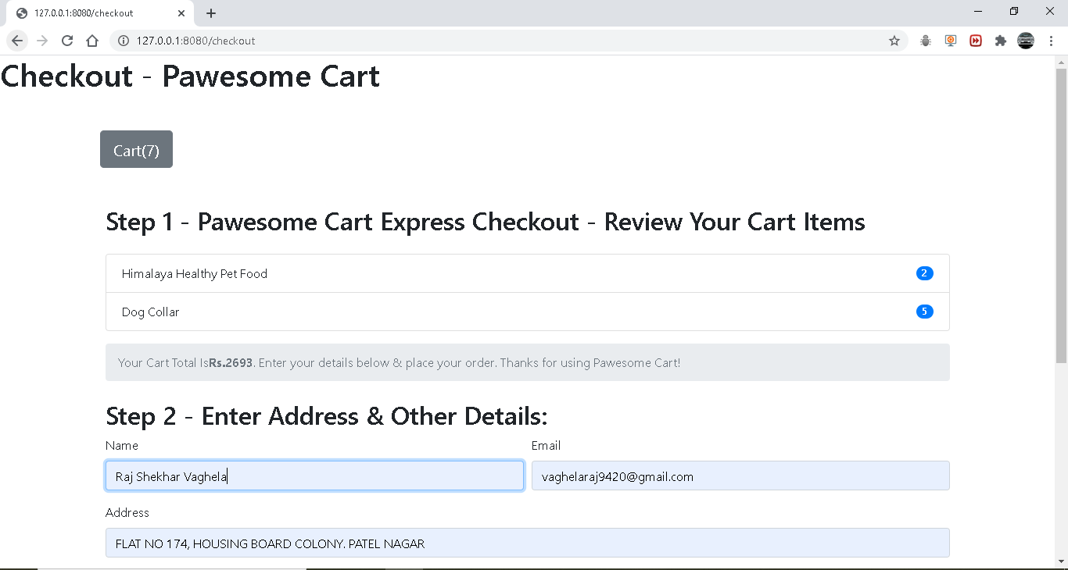
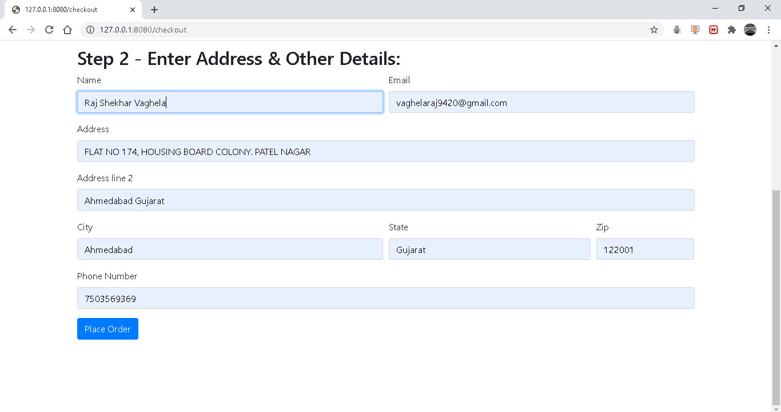
Buy - Pet Product - Checkout

Slide 25
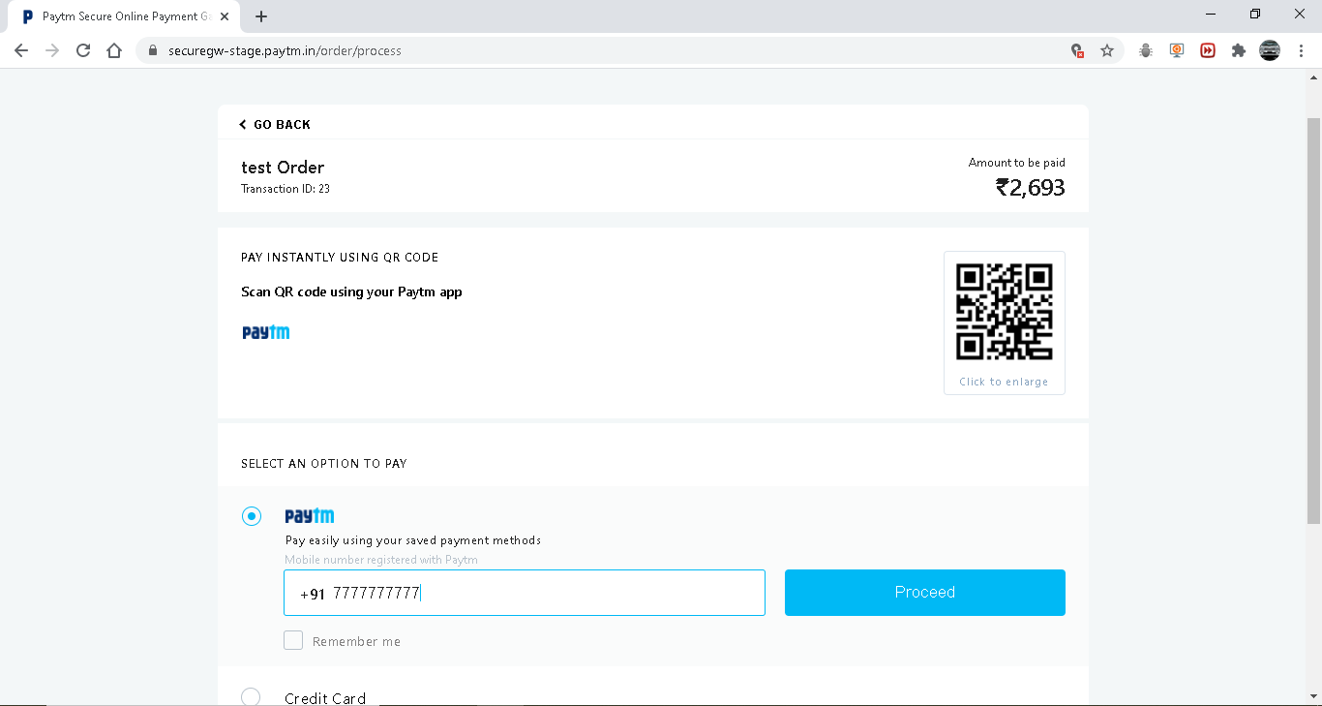
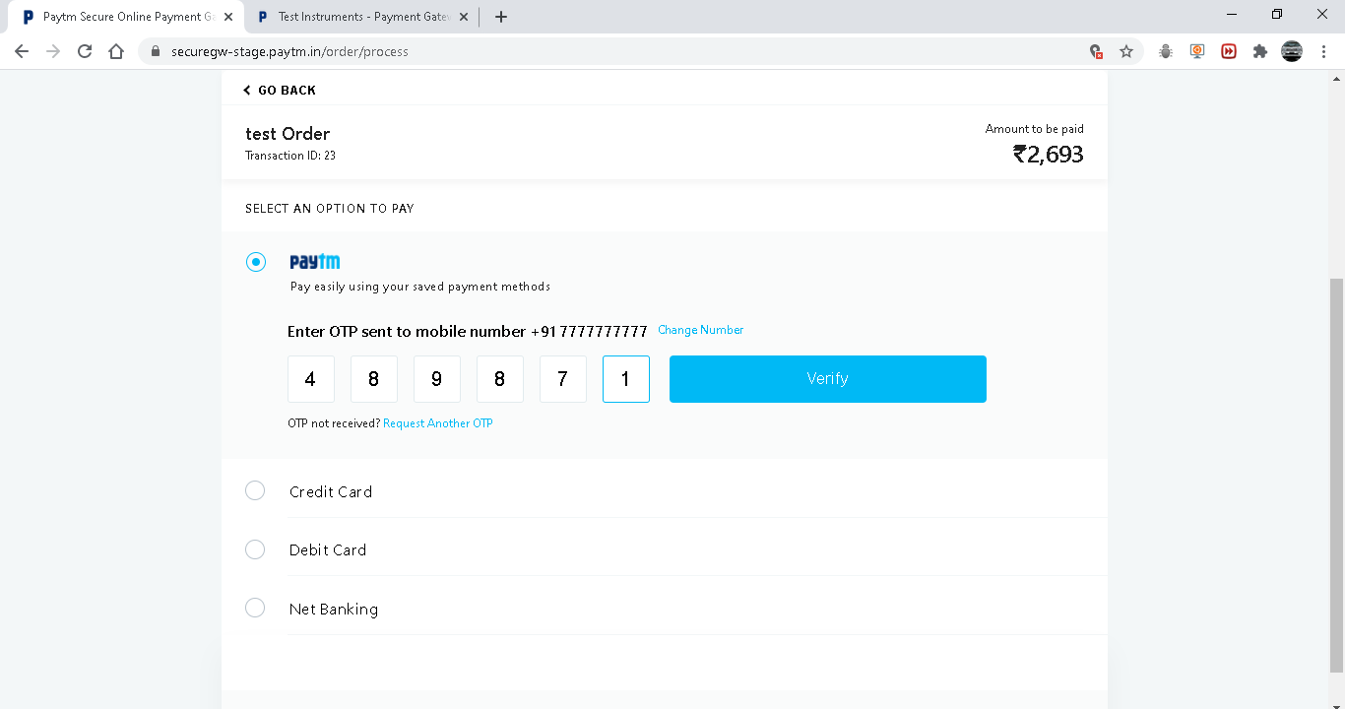
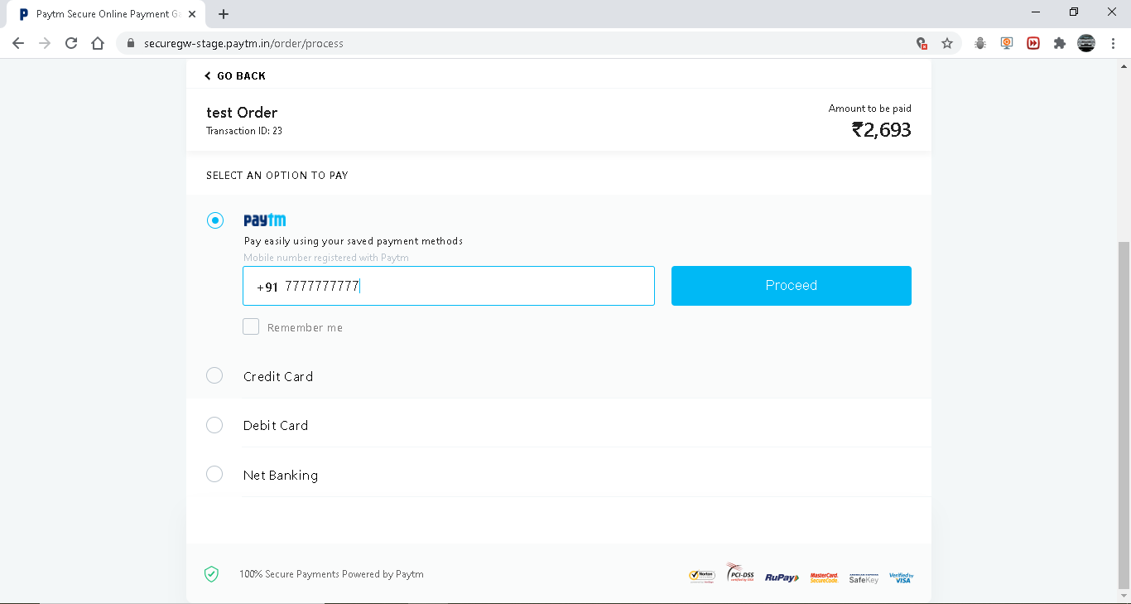
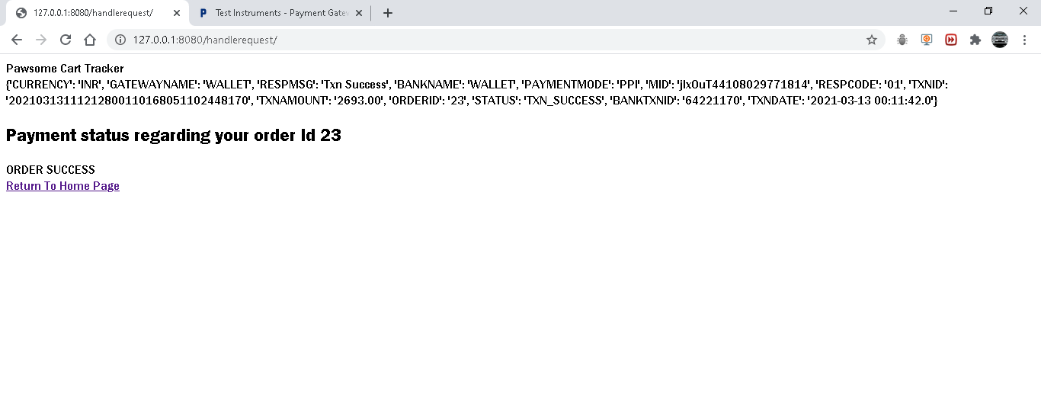
Buy - Pet Product - Payment

Slide 26
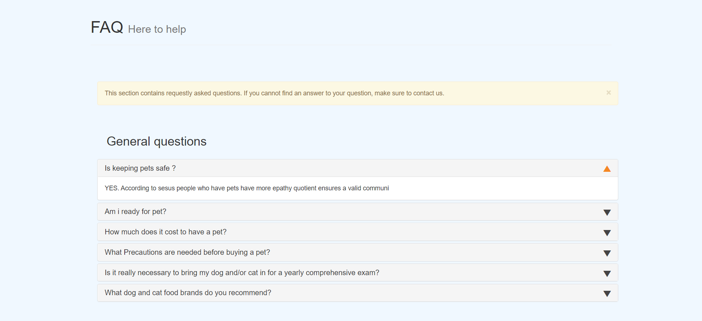
FaQ

Slide 27
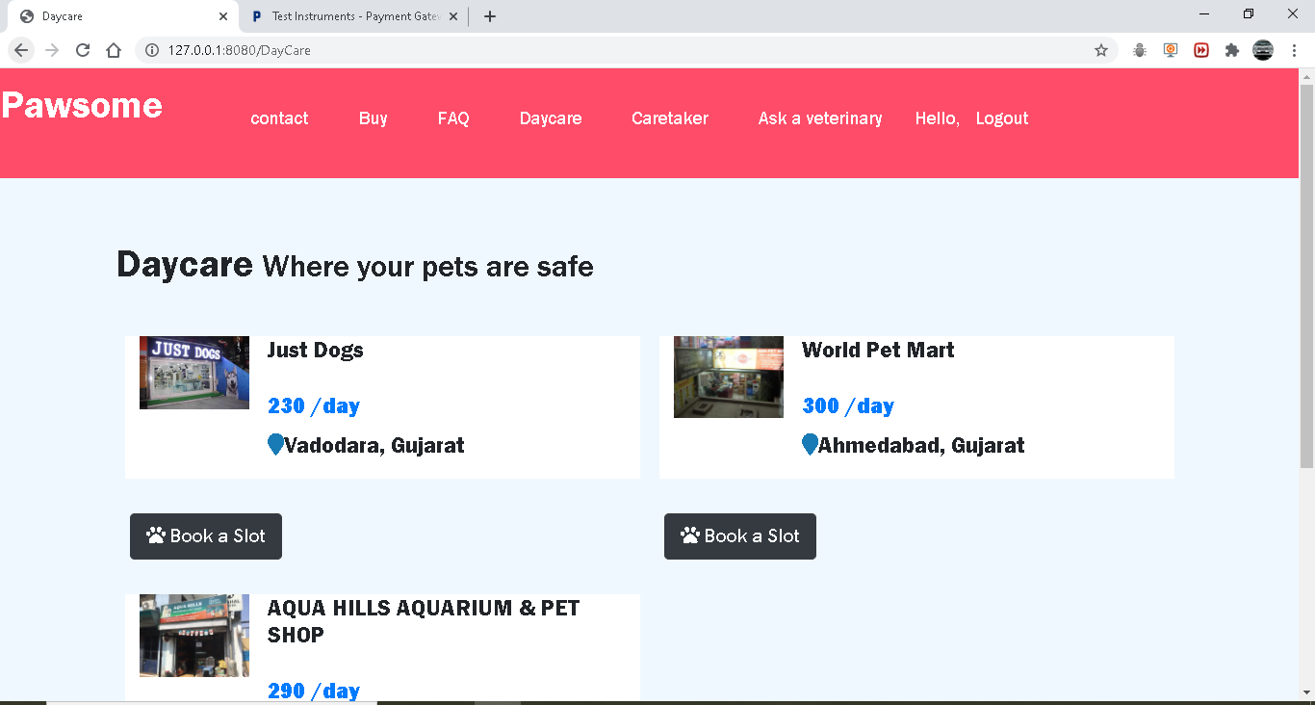
Daycare

Slide 28
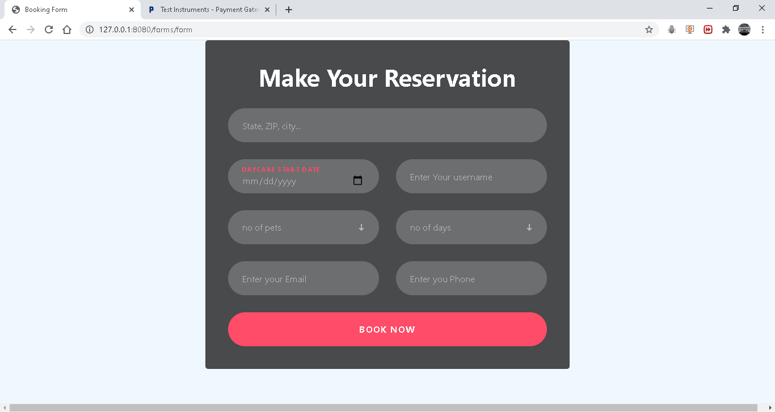
Daycare - Book a slot

Slide 29
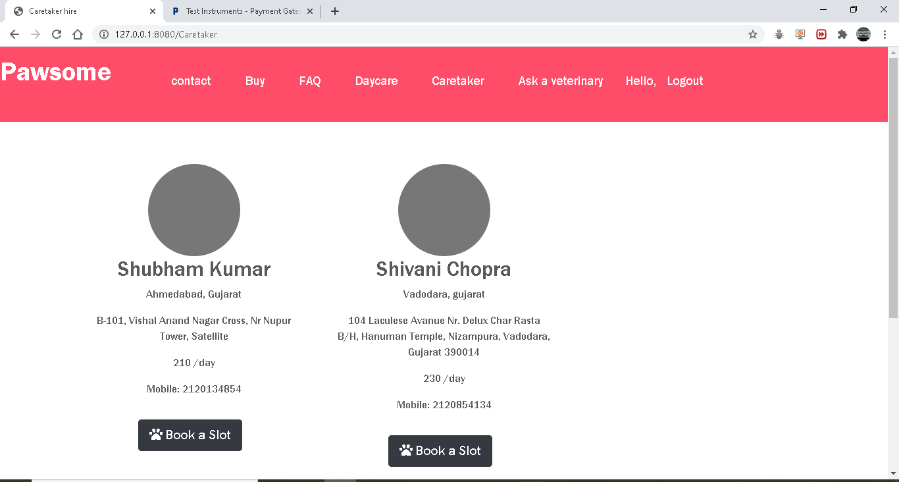
Caretaker

Slide 30
Caretaker - Book a slot

Slide 31
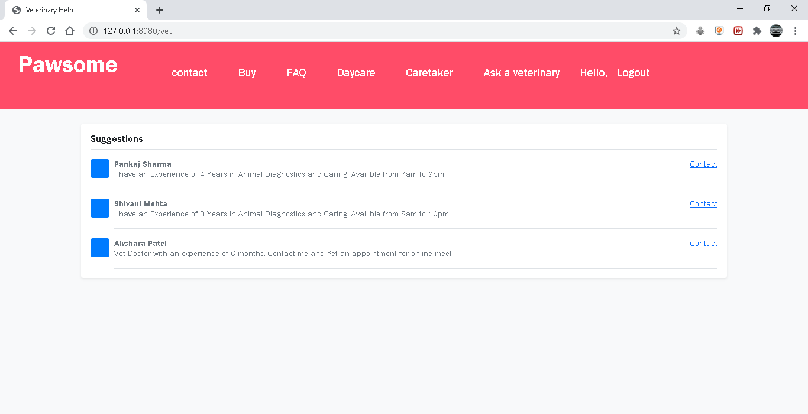
Ask a Vet

Slide 32
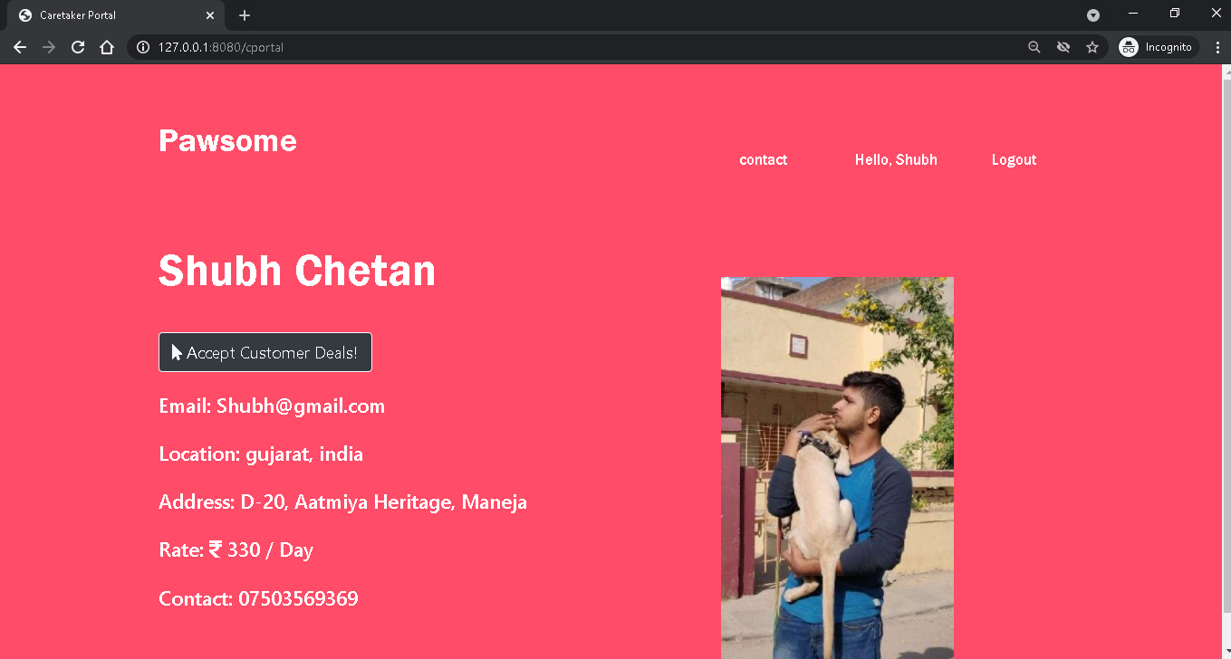
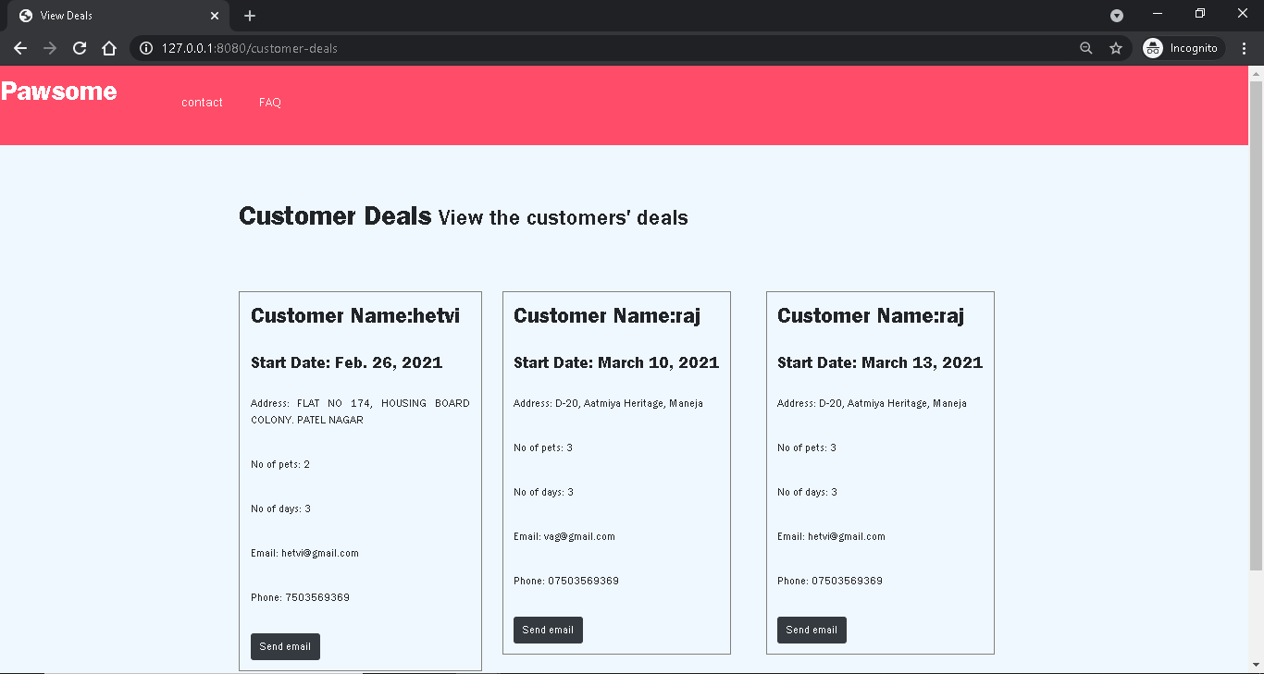
Caretaker Portal

Slide 33
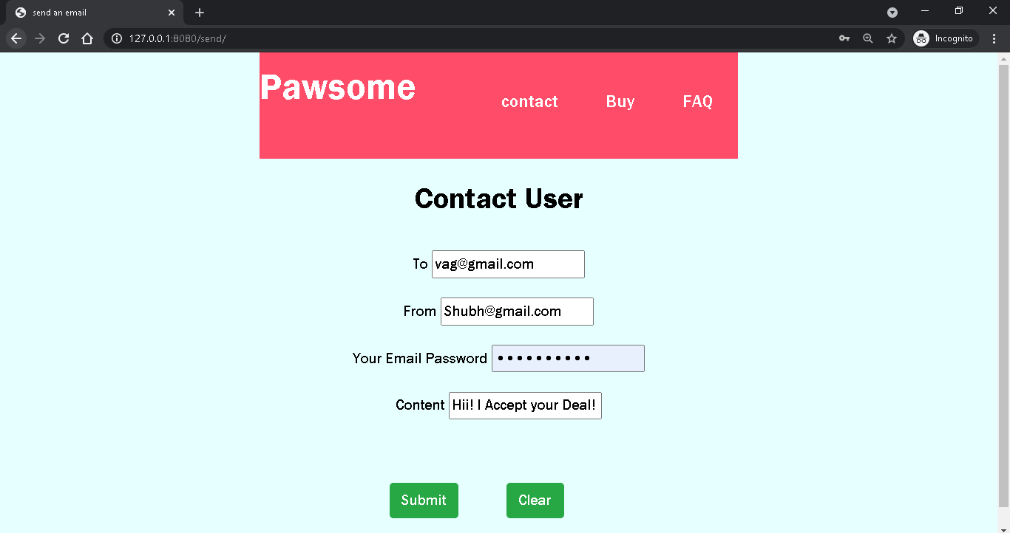
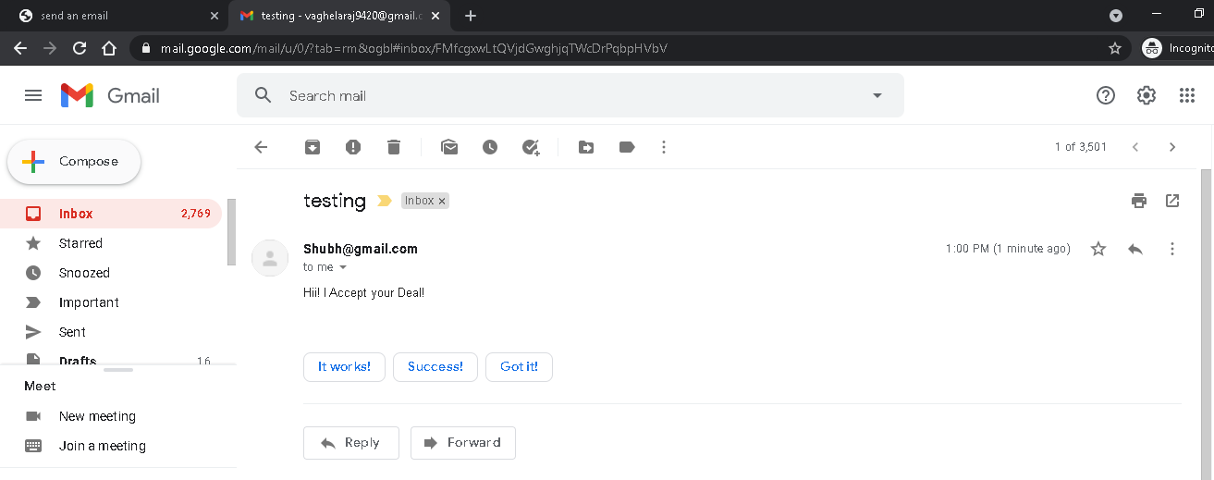
Caretaker Portal - Contact User

Slide 34
Test Case
Entity | Test Case | Expected Output | Actual Output | Status
Sign-up | Validation | Successfully register and redirect to log in page | Successfully register and redirect to log in page | Pass
View Pet Breeder | Post details | Display the pet breeder details for the specified pet | Display the pet breeder details for the specified pet | Pass
Payment | Confirm deal | PayTm Payment portal through which payment can be done by net banking, credit and debit card etc. | PayTm Payment portal through which payment can be done by net banking, credit and debit card etc. | Pass
Book Daycare | Post Details | Post available pet shops with option of book slots | Post available pet shops with option of book slots | Pass

Slide 35
Conclusion
We provide 1 step solution for all the requirements related to a pet
We have tried to keep the UI alluring and easy enough for our users to feel comfortable
There would be obvious limitation in users as our application would require internet connection
Small step to server the community by helping the ones who cant speak

Slide 36
Future Scope
Add more actors (eg. portal for daycare)
Add location related filters
Add features like suggest options based on past use
Automatic notification
Provide users benefits on the base of their use of application
Make mobile application

Slide 37
Reference
https://stackoverflow.com/
Various youtube channels
Link to all the project diagrams and all test cases:
https://drive.google.com/drive/folders/1B6EBX51WFScTglNDgkf79LHrUdiEihVt?usp=sharing

Slide 38
Thank You

